Slide 1

CS144 An Introduction to Computer Networks
Abstractions and Virtualization
Tags, Tunnels and Translation
Nick McKeown
Professor of Electrical Engineering
and Computer Science, Stanford University

Slide 2
The term “Virtual” is (over) used a lot…
Virtual LANs (VLAN)
Virtual Private Network (VPN)
Network Virtualization (used by cloud providers)
Network Function Virtualization (NFV)

Slide 3
Learning goals of this class
To learn how tags, tunnels and translation can be used to provide new abstractions in a network.
To learn about the match + action abstraction
To learn about three examples: Virtual LANs (VLANs), VPNs, and NATs.
To learn what network virtualization is.
To learn how overlay network virtualization works.
To learn what network function virtualization (NFV) is.

Slide 4
What do we mean by an abstraction?

Slide 5
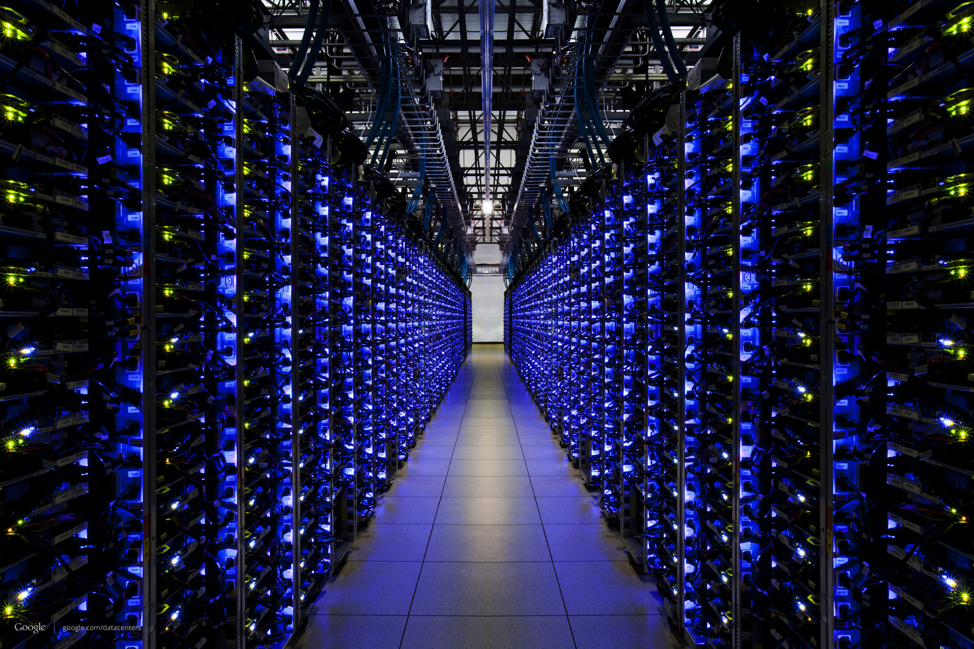
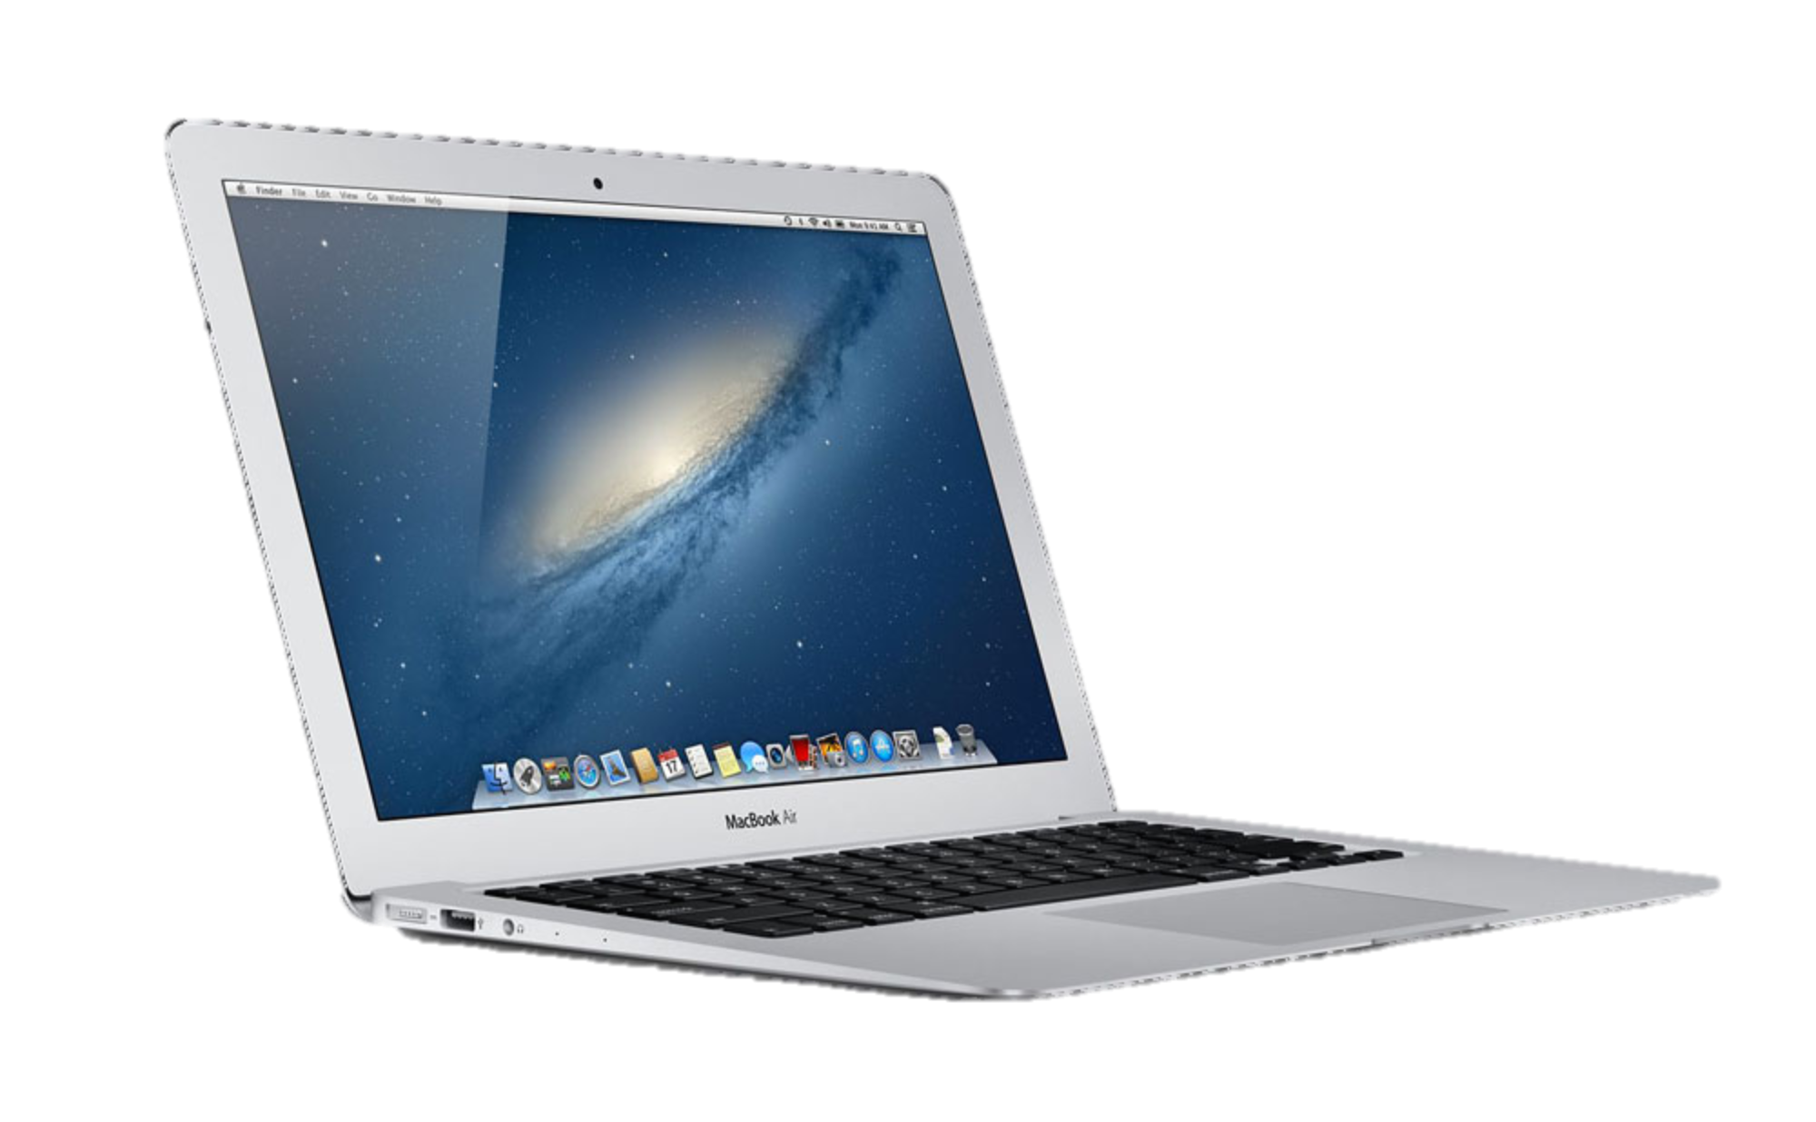
Example: IP datagram delivery
B
A

Slide 6
Example: IP datagram delivery
B
A
A
B
Abstraction: Packets with IP DA = B are delivered to B (with best effort)
The details of how it is accomplished are hidden from us.

Slide 7
IP Forwarding Abstraction
B
Match
Action
DA==B ?
Deliver
to B
Abstraction
X
B
A
B
Y
B
A
C
A
B
X
C
A
X

Slide 8
Firewall Abstraction
B
Match
Action
SA==X ?
Drop
In practice, a firewall rule might match on TCP ports as well.
e.g. If SA==X && dst port==80, then Allow
Abstraction
X
B
A
B
Y
B
A
C
A
B
X
C
A
X

Slide 9

Virtual LAN Abstraction
A3
S3
S2
S1
A2
A1
Goals
Packets on VLAN A never delivered to hosts on VLAN S
Packets in each VLAN follow their own spanning tree
Notes:
Examples: Engineers traffic doesn’t “see” the accounting servers
Or Student dorm traffic kept separate from campus traffic
Or My research group can connect directly to our server from anywhere on campus, but others can’t “see” my server.

Slide 10
Virtual LAN Abstraction
Mechanism
S3
Ethernet
S2
Payload
DA
SA
Ethernet
Payload
VLAN
Tag = S
DA
SA
S1
Abstraction
Match
Action
VLAN
Tag==S ?
Forward
on VLAN S

Slide 11

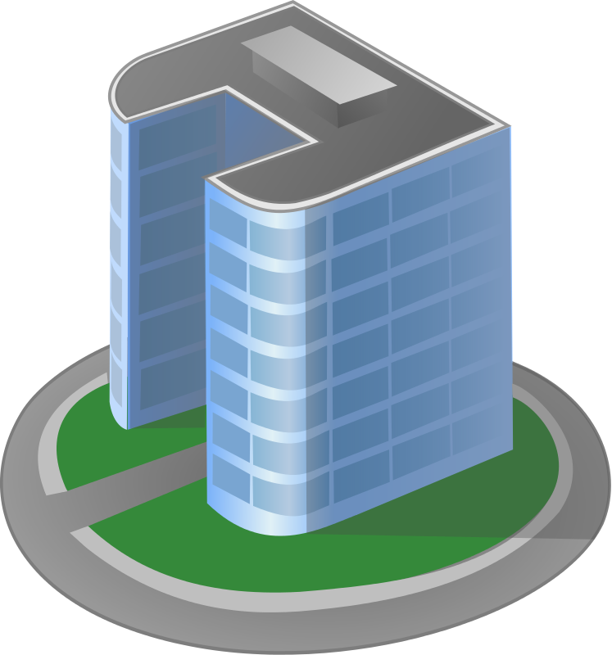
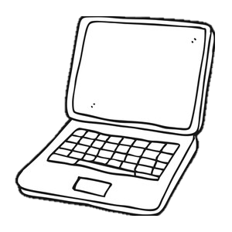
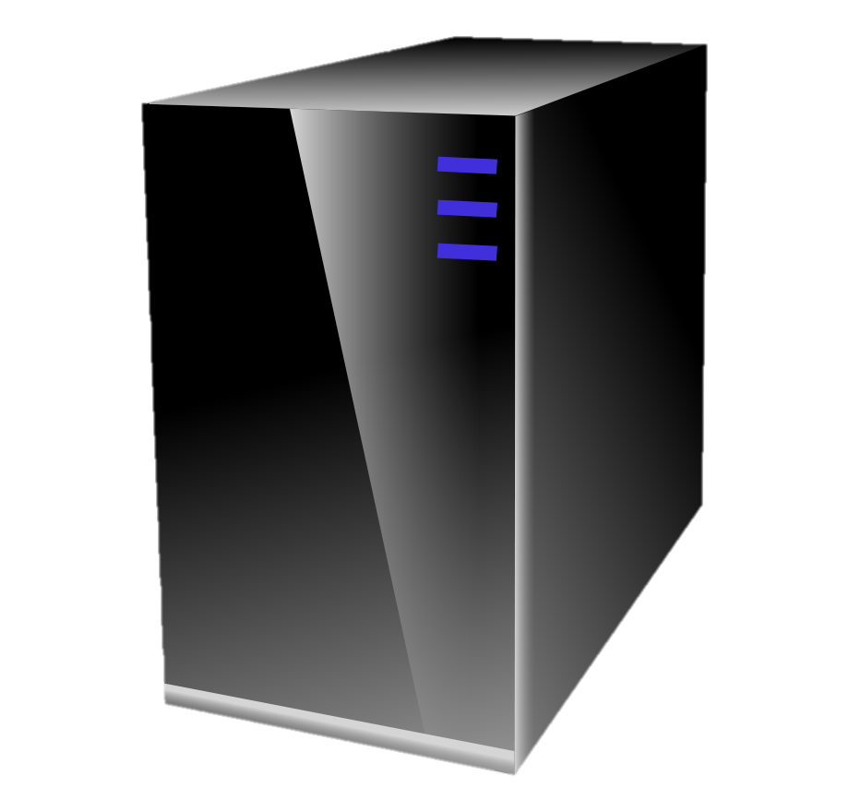
Example: Virtual Private Network (VPN) Remote client “appears to be” on corporate network
Web browser
IP Datagram
IP datagram
IP Datagram
Tunnel
Hdr
VPN Client
VPN Server
Public Internet
Corporate HQ
Notes:
Not a clean abstraction: Just abstracts forwarding, not control.

Slide 12
Example: Virtual Private Network (VPN)
Decapsulate incoming
Encapsulate outgoing
171.64.74.198
171.64.74.10
Web browser
IP datagram
IP Datagram
Tunnel
Hdr
IP Datagram
VPN Client
VPN Server
72.72.72.10
Public Internet
Corporate HQ
Match
Action
171.64/16
IP SA ==
171.64.74.198
Encapsulate in IP DA=171.64.74.10, SA=72.72.72.10
Forward to 171.64.74.10
Notes:
Not a clean abstraction: Just abstracts forwarding, not control.

Slide 13
Example: Network Address Translation (NAT) Multiple clients share a common IP address
Q: Why does NAT use translation instead of tags or tunnels?
“I am talking to 216.58.198.164”
“I am talking to 171.64.74.10”
X
171.64.74.10
A
Match
192.168.0.100
216.58.198.164
IP SA == 192.168.0.100
&& IP DA == 216.58.198.164
B
Action
“I am talking to 216.58.198.164”
Set IP SA=171.64.74.10
Replace TCP port numbers
Forward to 216.58.198.164
192.168.0.101
Notes:
Not a clean abstraction: Just abstracts forwarding, not control.

Slide 14
“Modularity based on abstraction is the way things are done!”
Barbara Liskov (MIT) Turing Award Lecture 2009
Notes:
As Barbara Liskov said about computer science: “Modularity based on abstraction is the way things are done!” Abstractions are arguably the foundation upon which computers and entire data-centers are built.
I actually think the past ten years in networking has been all about creating new abstractions for network control planes.

Slide 15
Learning goals of this class
To learn how tags, tunnels and translation can be used to provide new abstractions in a network.
To learn about the match + action abstraction
To learn about three examples: Virtual LANs (VLANs), VPNs, and NATs.
To learn what network virtualization is.
To learn how overlay network virtualization works.
To learn what network function virtualization (NFV) is.

Slide 16
Network Virtualization

Slide 17
Abstractions in computer systems
Virtual memory Abstract illusion of infinite, private physical memory
File system Uniform illusion of read/write data store.
Virtual Machine User application cannot tell if it is running on a physical or virtual machine.
…
Notes:
The world of computing is built on a foundation of clever abstractions.
The abstraction of virtual memory means our applications don’t have to worry about managing physical memory locations and caches. Abstractions for file systems means our applications can open, update and close files without needing to know what hardware the file system uses, or where it is located. The abstraction of an operating system means our applications don’t have to worry about how processes are scheduled and peripherals are shared.

Slide 18
Virtual Network: The abstraction
The abstraction (or illusion) of a physical network: The user, application (and possibly the network administrator too) cannot tell if the network is physical or virtual.

Slide 19
Virtual Network: The abstraction
A set of VMs operating as if connected to the same physical network.
Typically belonging to the same tenant.
VMs communicate with each other using their own address space.
Virtual networks are isolated from each other: They cannot communicate, except through a gateway.
VMs can migrate to a different server without changing IP address.
A virtual network has a SLO expressed as a desired quality of service (e.g. data rate, reliability, latency)
A VM can operate as if on the tenant’s home network.
Used for containers too
Notes:
It says VM, but in practice could also be a physical server or a container. Here, we will only consider VMs.

Slide 20
Virtualized Data Center
Switch
Switch
Switch
Switch
Switch
Switch

Slide 21
Abstraction for tenant VMs
Tenant 1
VM
VM
VM
VM
VM
VM
VM
VM
VM
VM
171.64/16
Tenant 2
VM
VM
VM
VM
VM
VM
VM
VM
VM
VM
8.4.1/24
Tenant 3
VM
VM
VM
VM
VM
VM
VM
VM
VM
128.30.2/24

Slide 22
VMs using their own IP addresses
All orange tenant VMs are part
of the 128.30.2/24 subnet
VMs using their own IP addresses
VM
VM
VM
VM
VM
VM
128.30.2.4
171.64.74.155
128.30.2.2
171.64.74.157
Physical network
192.5.0.1
192.5.0.3
VM
VM
VM
VM
VM
VM
128.30.2.3
171.64.74.156
128.30.2.1
171.64.74.158
192.5.0.2
192.5.0.4
Q: Which mechanism Tag, tunnel or translation?

Slide 23
Mechanism: Tags, Tunnels or Translation?
Any mechanism could be made to work.
Tags: Switches contain a forwarding table per tenant.
Tag in every packet indicates the tenant and therefore the forwarding table to use.
But: We need to change the switches to recognize the tag and forward based on it.
Translation: Use NAT, with port numbers identifying VMs.
But: Both ends behind NATs, therefore need NAT traversal everywhere – complicated.
But: With thousands of VMs per server, quickly run out of port numbers for mapping.
Tunnel: Create tunnel between every pair of servers. Forward traffic between VMs through the tunnel.
But: We need to change switches to create tunnels.
But: Server will receive packets for all addresses used by its VMs.

Slide 24
How it is done in virtualized data centers

Slide 25
1: Use the software “vSwitch” in every server
VM
VM
VM
Virtual Switch
“vSwitch”
Ethernet
NIC
Host OS
Maintains tunnel to every other server’s vSwitch
Tags packets with tenant ID
Forwards packets into tunnel

Slide 26
2: Forward packets in tunnels between vSwitches
IP datagram from VM-A to VM-B
IP Data
128.30.2.4
128.30.2.2
“If destination is remote,
encapsulate in IPsec”
A
B
VM
VM
VM
VM
VM
VM
128.30.2.4
171.64.74.155
128.30.2.2
171.64.74.157
X
192.5.0.1
192.5.0.3
Y
IP datagram from VM-A to VM-B
192.5.0.1
192.5.0.3
IP Data
128.30.2.4
128.30.2.2
IP datagram from server X to server Y
VM
VM
VM
VM
VM
VM
128.30.2.3
171.64.74.156
128.30.2.1
171.64.74.158
192.5.0.2
192.5.0.4

Slide 27
Learning goals of this class
To learn how tags, tunnels and translation can be used to provide new abstractions in a network.
To learn about the match + action abstraction
To learn about three examples: Virtual LANs (VLANs), VPNs, and NATs.
To learn what network virtualization is.
To learn how overlay network virtualization works.
To learn what network function virtualization (NFV) is.

Slide 28
Network Function Virtualization (NFV)
Data
HDR
Public Internet
VM
VM
VM
Middlebox
Data
HDR
VM
VM
VM
Firewall
Load-balancing
NAT
Deep Packet Inspection
DDoS Mitigation
Benefits of NFV
Moves expensive hardware to software
Easier to scale out on demand
Easier to add new functions over time

Slide 29
Learning goals of this class
To learn how tags, tunnels and translation can be used to provide new abstractions in a network.
To learn about the match + action abstraction
To learn about three examples: Virtual LANs (VLANs), VPNs, and NATs.
To learn what network virtualization is.
To learn how overlay network virtualization works.
To learn what network function virtualization (NFV) is.

Slide 30
Thank you!

